Slide 1

5. Promote Domain Controller on Server Core
Windows Server 2019 Basics

Slide 2
What to check first
Server name
IP settings – make sure that you have a DNS server that can point you to the domain you want to join (in my case I have to set 192.168.20.1 which is the IP of Lab-DC01)
Notes:
Before promoting the domain controller make sure you change the name to whatever you want the DC to be called and check the IP settings. It is important the you have at least a DNS server that can point this server to the domain you want to join (in this case it will be our first domain controller we promoted).

Slide 3
Steps
Join server to the domain as a member server
Install the Active Directory Domain Services role
Promote the server to a domain controller
Restart the server after promotion is finished
Set DNS settings on both domain controllers
Notes:
The general steps to install a domain controller are:
- Join server to the domain
- Install the ADDS role
- Promote the server to a domain controller
- Make sure you restart the server after that if it does not do it automatically
- Configure DNS settings on this DC and also the first one

Slide 4
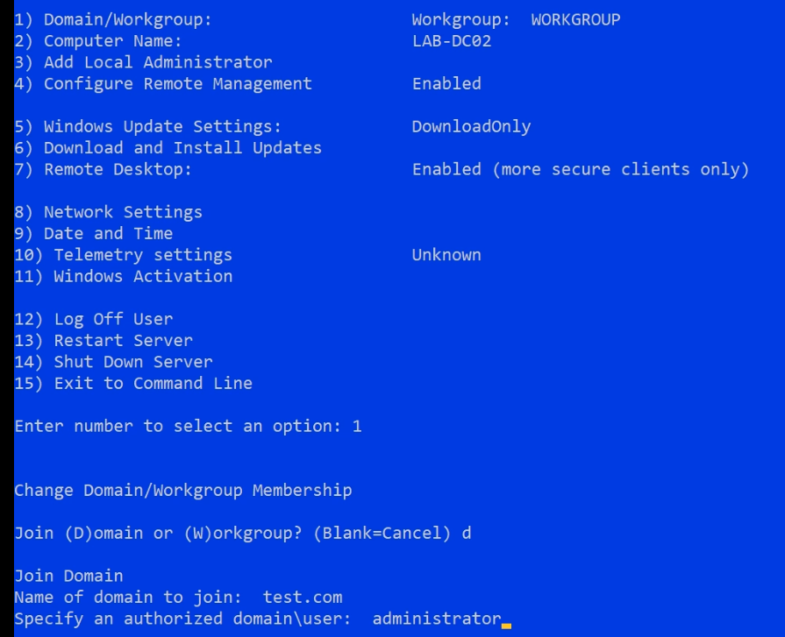
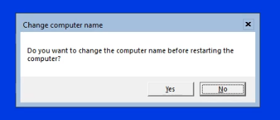
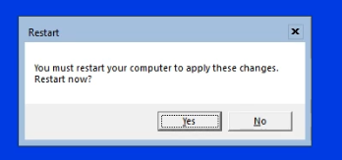
Join server to the domain
Notes:
You can use Sconfig to join the server to a domain (Powershell can also be used of course). Just type 1, then D for domain and enter the domain you want to join and a user from that domain that has rights to add new computers. Enter the user’s password when prompted.
Since we took care of changing the computer name you can click on No at the prompt.
Of course a restart is needed before we can continue.

Slide 5
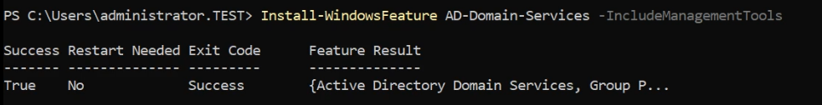
Install the ADDS role

Slide 6
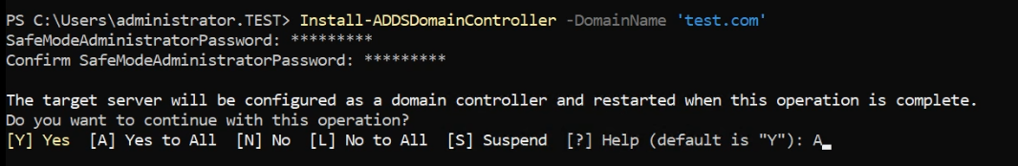
Promote the server
Notes:
Promoting from Powershell just means running a command. The AD Restore user password can be given as a parameter but in this case I chose to enter it from the console when prompted for it.
DNS will be installed and configured by default so no need to specify it here.

Slide 7
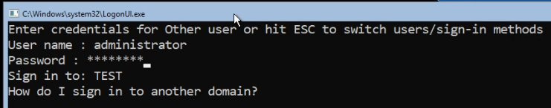
Log on using domain credentials
Notes:
After the server has restarted you can log on. Notice that the log on location is actually the domain TEST. This means that the user you will use is not stored on the server locally but in the AD database.

Slide 8
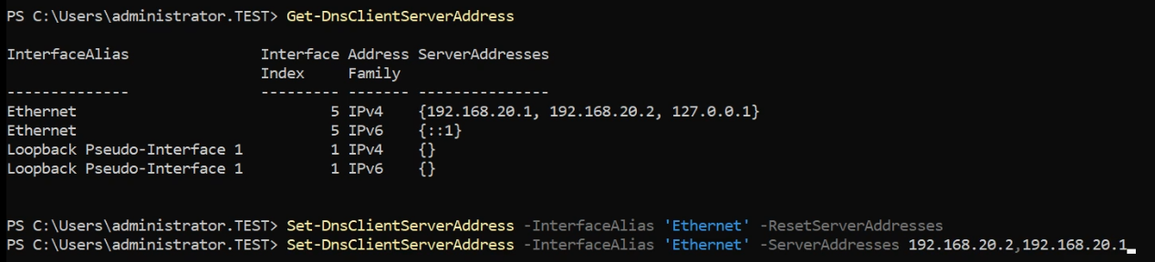
Set the DNS servers
Notes:
For the DNS settings I like to set the local server as the primary DNS and the other one as the secondary. I also like to remove the loopback addresses or both IPv4 and IPv6.

Slide 9
https://www.youtube.com/channel/UCcZ-jLbPwNr8E_v9-65n8Iw https://github.com/itknowledge4

